Slide 1
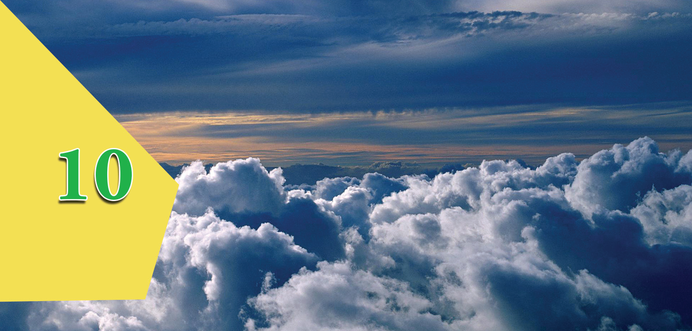
Blanket of The Earth

Slide 2
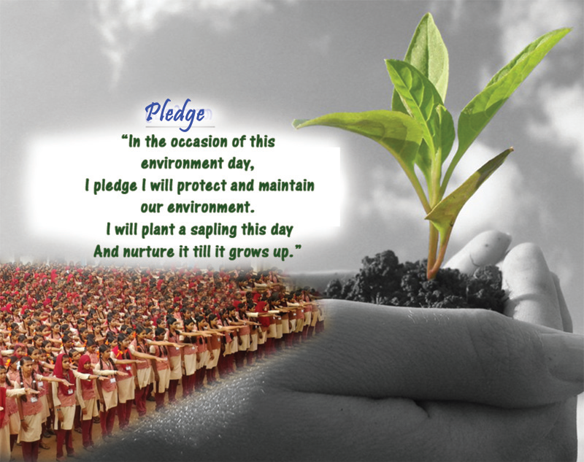

Slide 3
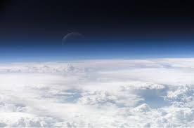
The atmosphere of Earth is the layer of gases, commonly known as air, that surrounds the planet Earth and is retained by Earth's gravity.

Slide 4
Atmospheric Composition
Gases, moisture and dust particles are the major constituents of our atmosphere that blanket our earth.
It is the gravitational attraction of the earth that holds the atmosphere close to the earth.

Slide 5
The presence of atmosphere extends to about 10000 kilometres from the earth's surface.
But it is estimated that about 97 percentage of the atmospheric air remains within 29 kilometres from the earth's surface.
The gases get rarefied with increasing altitude.

Slide 6
Atmospheric gases
Gases Volume (%)
Nitrogen 78.08
Oxygen 20.95
Argon 0.93
Carbon dioxide 0.037
Ozone 0.01
Neon 0.002
Helium 0.0005
Krypton 0.0001
Hydrogen 0.00005
Xenon 0.00009

Slide 7
The importance of gases such as oxygen, carbon dioxide and nitrogen in the existence of life forms.
Plants make use of Carbon dioxide for photosynthesis.
Man and other organisms make use of oxygen for respiration.
Plants make use of nitrogen for their growth through nitrogen fixation.

Slide 8
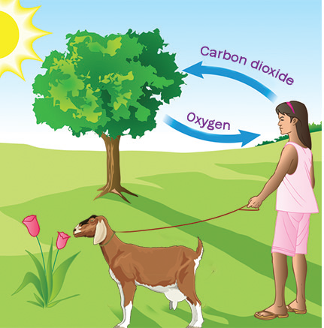
Respiration

Slide 9
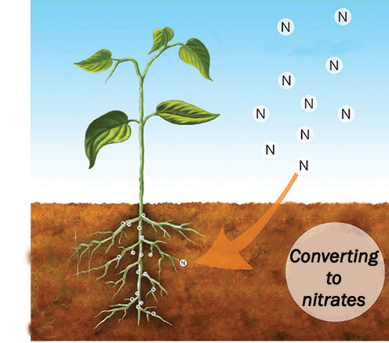
Nitrogen fixation

Slide 10
Photosynthesis

Slide 11
Water in the atmosphere
Water molecules are a major constituent in the lower parts of the atmosphere.
Water reaches the atmosphere through evaporation and causes cloud formation and rain.

Slide 12
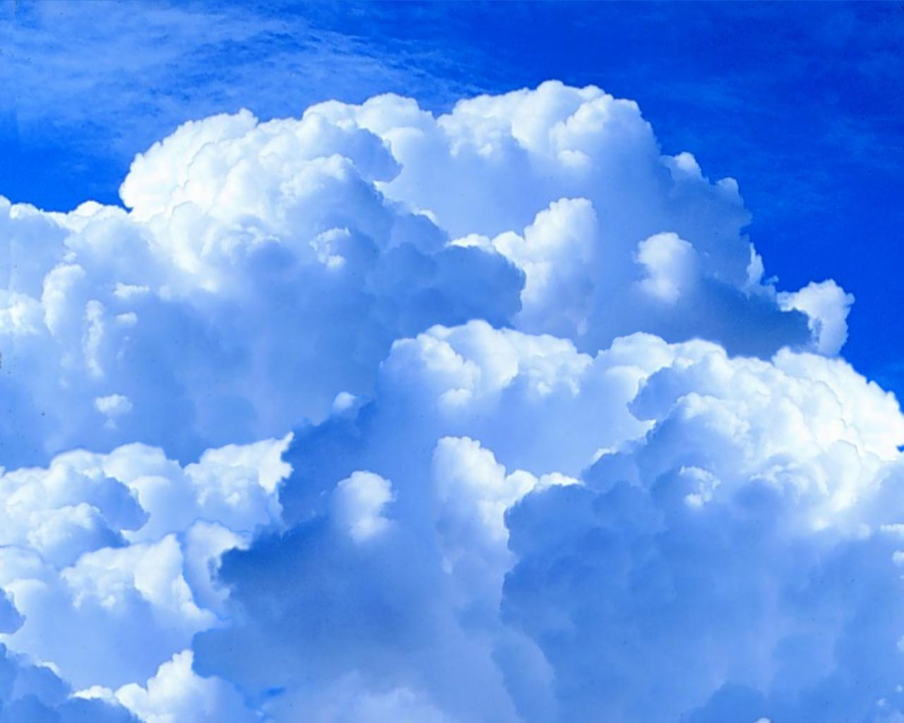

Slide 13
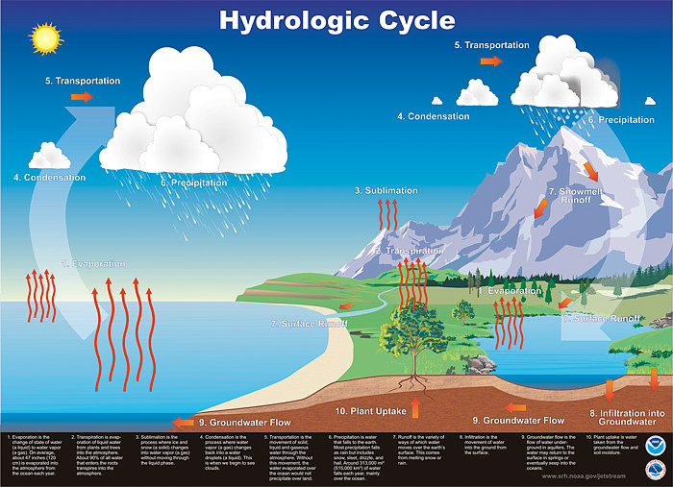

Slide 14
Dust Particles
The main sources of dust particles to the atmosphere.
Dust particles brought to the atmosphere by wind.
Dust particles erupted through volcanoes.
Ash formed by burning of meteors.

Slide 15
the factors influencing the amount of water in the atmosphere.
Rate of evaporation will be high at places experiencing higher temperature. So the water content in such places will be high.
The amount of water will be high in the atmosphere close to the surface water sources such as oceans, rivers and other water bodies.

Slide 16
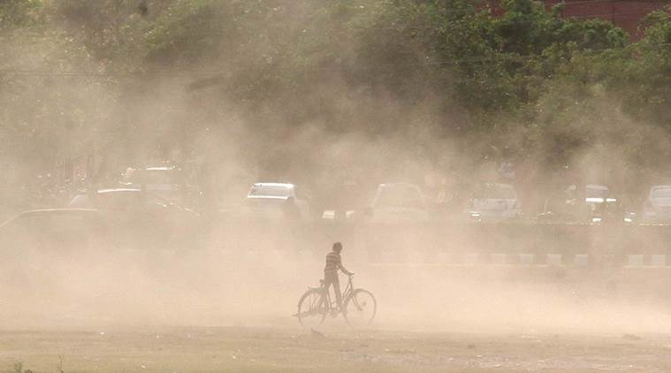

Slide 17
Condensation nuclei
Dust particles in the atmosphere help in cloud formation. So they are called as Condensation nuclei.

Slide 18
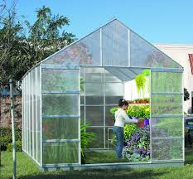
Green house

Slide 19
Why glass is largely used in the construction of buildings in cold countries?
Glass panes have the capacity to allow insolation to pass through them and check the terrestrial radiation.
Thus temperature is maintained within the buildings without fall.
By preventing the terrestrial radiations the temperature required for the growth of plants is retained inside such constructions.
Such buildings are called Green houses.

Slide 20
Atmosphere as a Green house
Gases such as Carbon dioxide, methane, ozone etc. and water vapour present in the atmosphere absorb the terrestrial radiation and retain the temperature of the atmosphere.
This phenomenon is called Greenhouse effect and the gases causing the phenomena are called Greenhouse gases.

Slide 22
But the uncontrolled increase in the greenhouse gases causes rise in temperature in the atmosphere.

Slide 23
The sources of greenhouse gases?
natural means
volcanic eruptions,
decay of biological matter..
human activities
deforestation,
burning of fossil fuels etc.

Slide 24
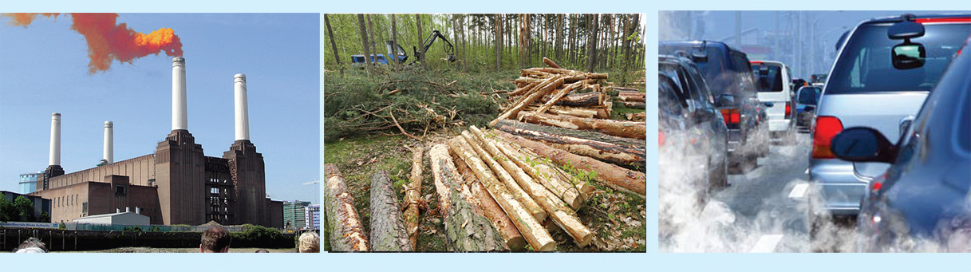

Slide 25
how Global warming becomes a threat to the life forms of the earth.
Sea level may rise as a result of melting of polar ice.
Destruction in the coastal ecosystem may lead to the problems such as food crisis, large scale migration etc.
Global warming leads to the depletion of many species of plants and animals in the ecosystem.

Slide 26
Global warming
Industrialisation, urbanisation etc. lead to rapid changes in the atmosphere.
It is estimated that 6000 metric ton carbon dioxide is getting added to the atmosphere every year in this manner.
Studies reveal that there is a rise of 0.4°C in the average atmospheric temperature due to uncontrolled increase of greenhouse gases in the 20th century.
The increase in temperature in the atmosphere due to greenhouse gases is referred as Global warming.

Slide 27

Ozone as an umbrella for the earth
the ozone gas is concentrated in the upper atmosphere as a layer, it is called Ozone layer.
It protects the life forms of the earth by absorbing the harmful ultraviolet rays from the sun.

Slide 28
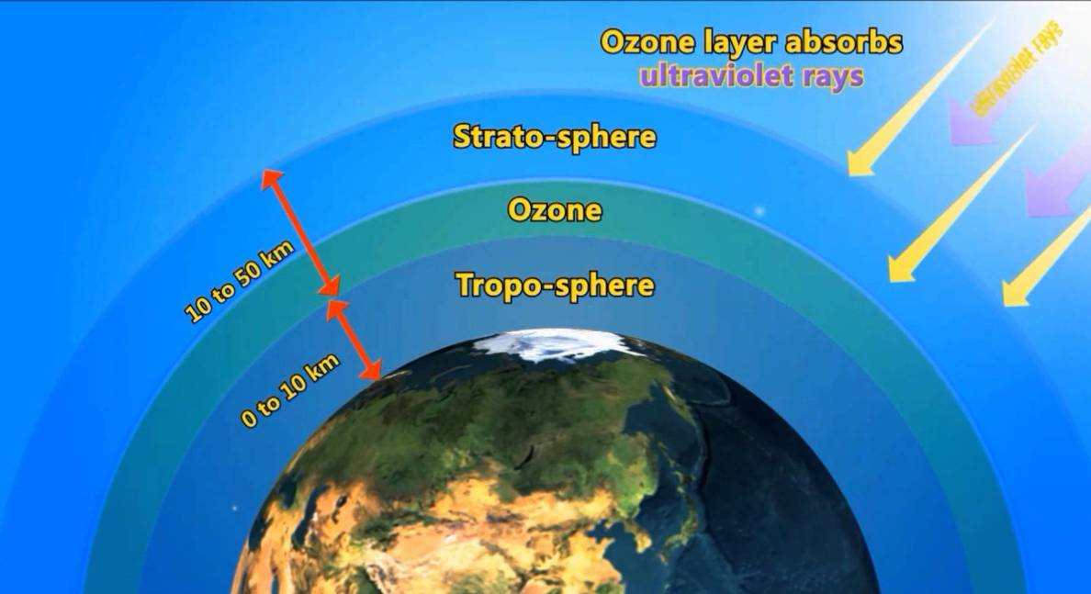

Slide 29
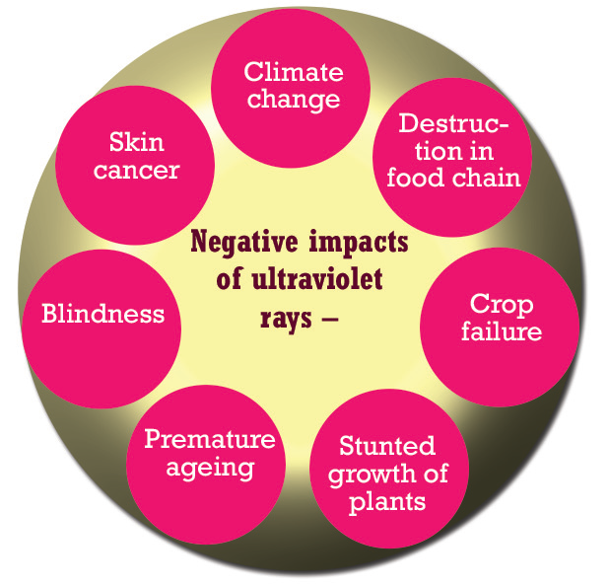

Slide 30
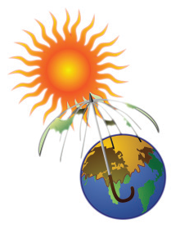
Ozone hole
Refrigerators, air conditioners, different types of sprays, fire extinguishers, paints, etc. are sources of gases such as chlorofluorocarbons, halon etc.
These gases rising to the upper atmosphere react with ultraviolet rays from the sun to form chlorine and bromine.
It is estimated that each chlorine atom is capable to decay about one lakh of ozone molecules.
Bromine is 40 times more reactive than chlorine.
This depletion in the atmospheric ozone layer is called as Ozone hole.

Slide 31
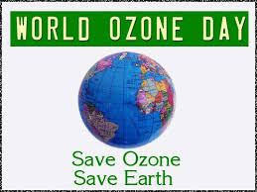
To protect the ozone layer…
To create awareness on the need of conservation of ozone and to control the use of products leading to ozone depletion 16th September of every year is observed as World Ozone Day.

Slide 32
Structure of the Atmosphere
The composition of the atmosphere is somewhat uniform up to about 90 Kilometres from the surface of the earth.
This part of the atmosphere is called homosphere.
Beyond this there is no uniformity in the gaseous composition.
So the part of the atmosphere beyond 90 Km from the earth is called as heterosphere.

Slide 33
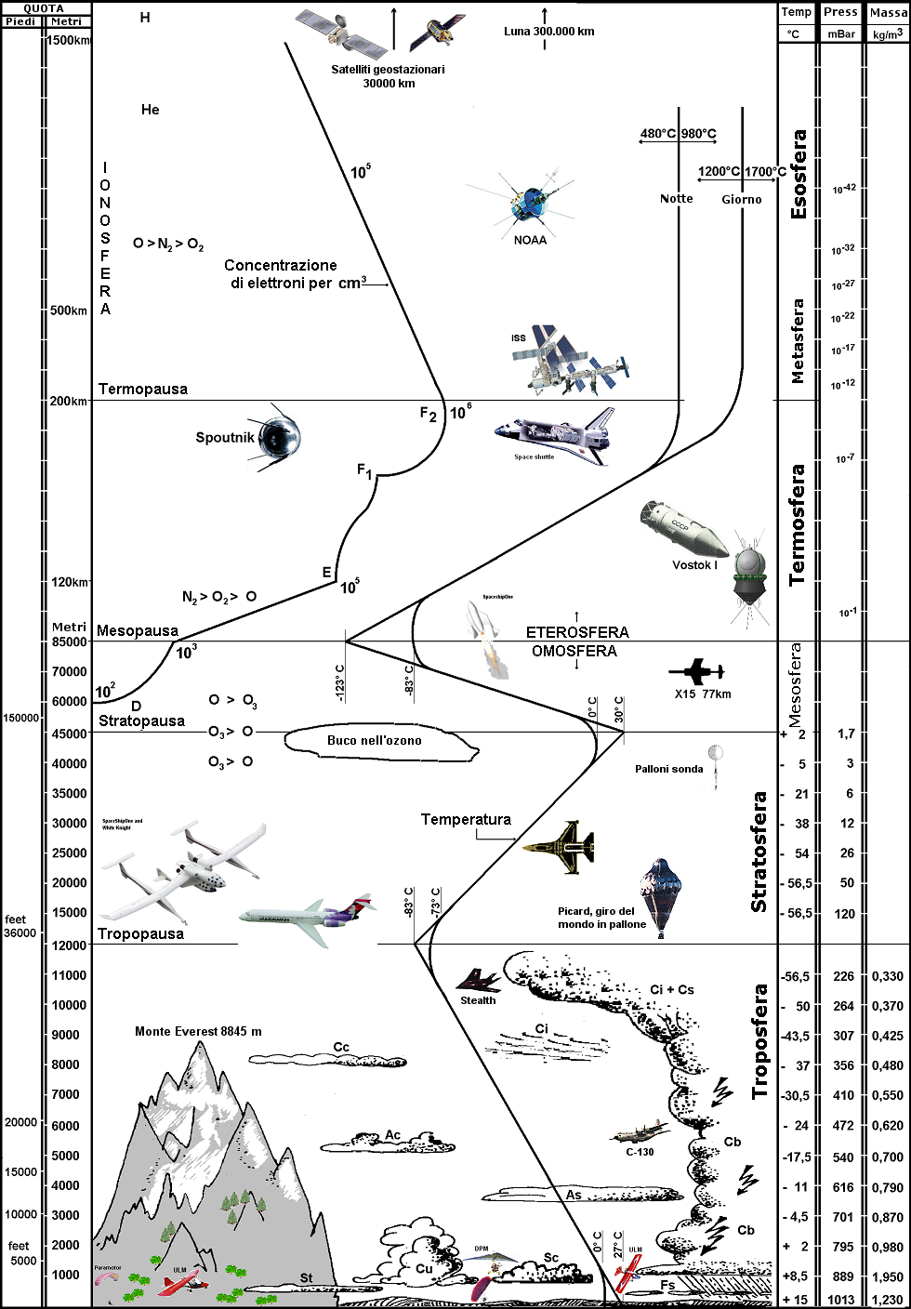
Based on the temperature at different levels, atmosphere can be divided into different layers

Slide 34
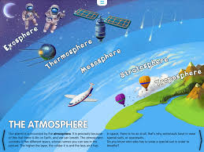

Slide 35
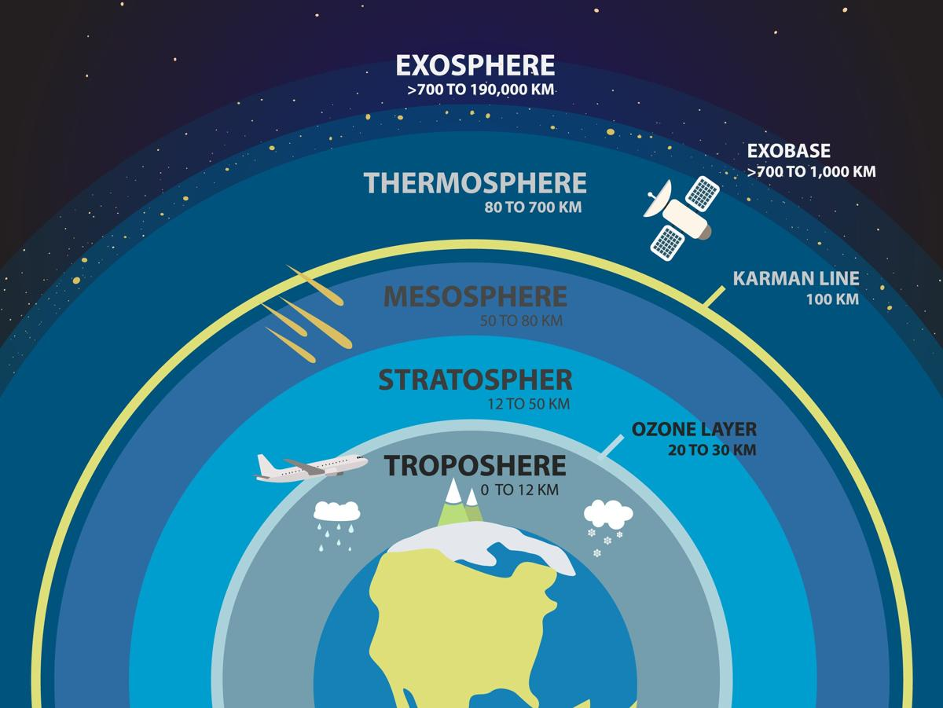

Slide 36
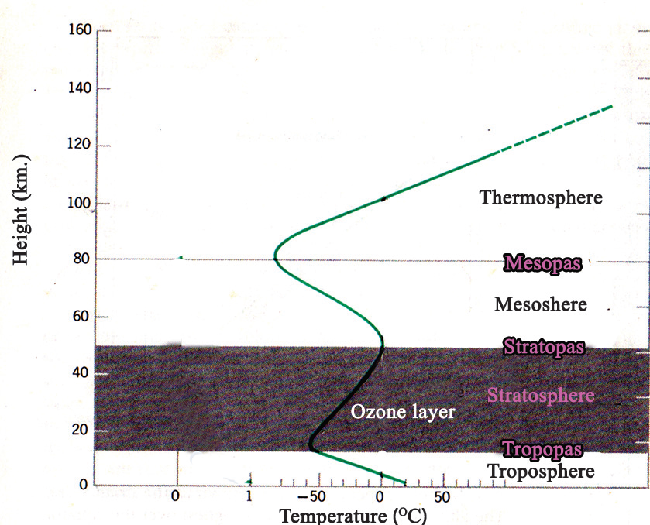

Slide 37
Troposphere
This layer extends up to about 90 Km from the surface of the earth and lies close to the earth.
The height of the troposphere is more in the equatorial regions because of strong convection here. (about 18 Km)
Almost all the weather and climatic phenomena such as cloud formation, rain, snow, wind, thunder and lightning etc. take place in this layer.
In the troposphere the temperature decreases at a uniform rate of 1°Celcius for every 165 metres of altitude. This is called Normal Lapse Rate.
The zone of transition above the troposphere is called tropopause.

Slide 38
Stratosphere
Extends up to a height of about 50 Km from the earth and lies above the tropopause.
In the lower parts of the stratosphere there is no change in temperature with altitude.
This zone is called isothermal zone.
Beyond this there is increase in temperature with altitude.
Ozone layer which forms part of this layer absorbs the harmful ultra violet rays from the sun and prevents it from reaching the earth.
Allows the free movement of jet aircrafts through clear atmospheric conditions and absence of air gutters.
The zone of transition above the stratosphere is called stratopause.

Slide 39
Mesosphere
Extends from about 50 to 80 Km altitude from the earth.
Temperature decreases with altitude and the lowest temperature of the atmosphere is felt at the mesopause. ( -80°C to -100°C)
The meteors on reaching the mesosphere gets burnt out due to friction.
The zone of transition above the mesosphere is called mesopause.

Slide 40
Thermosphere
Extends from about 80 to 600 Km altitude.
There is considerable increase in temperature with altitude.
The lower part of the thermosphere is known as ionosphere.
Ionosphere helps in the transmission of radio waves.

